Slide 1

I Came Here To Drink Milk and Analyse Data

Slide 2


Slide 3

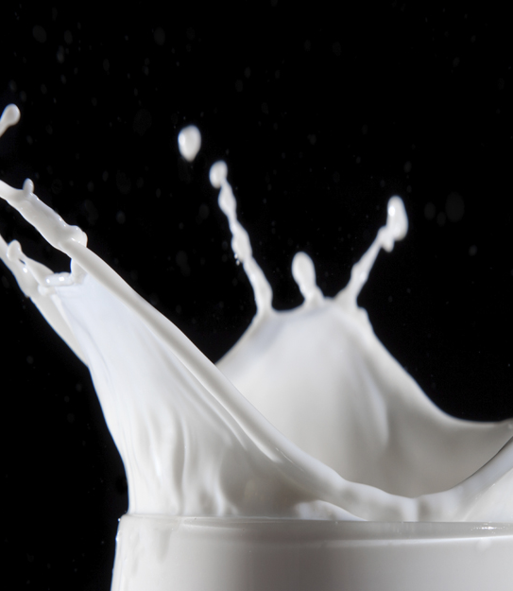
Introduction
Welcome to my Data Analysis Presentation
Predicting the quality of milk
Vital part of the Irish economy
Impact on environment
Milk is just great

Slide 4
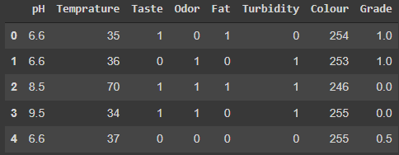
Dataset

Slide 5
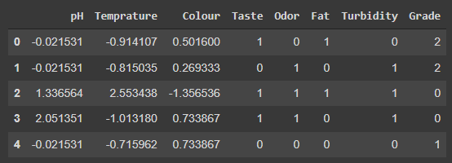
Cleaning and Transforming the Data
Pandas
Standard Scalar
Mapping variables

Slide 6
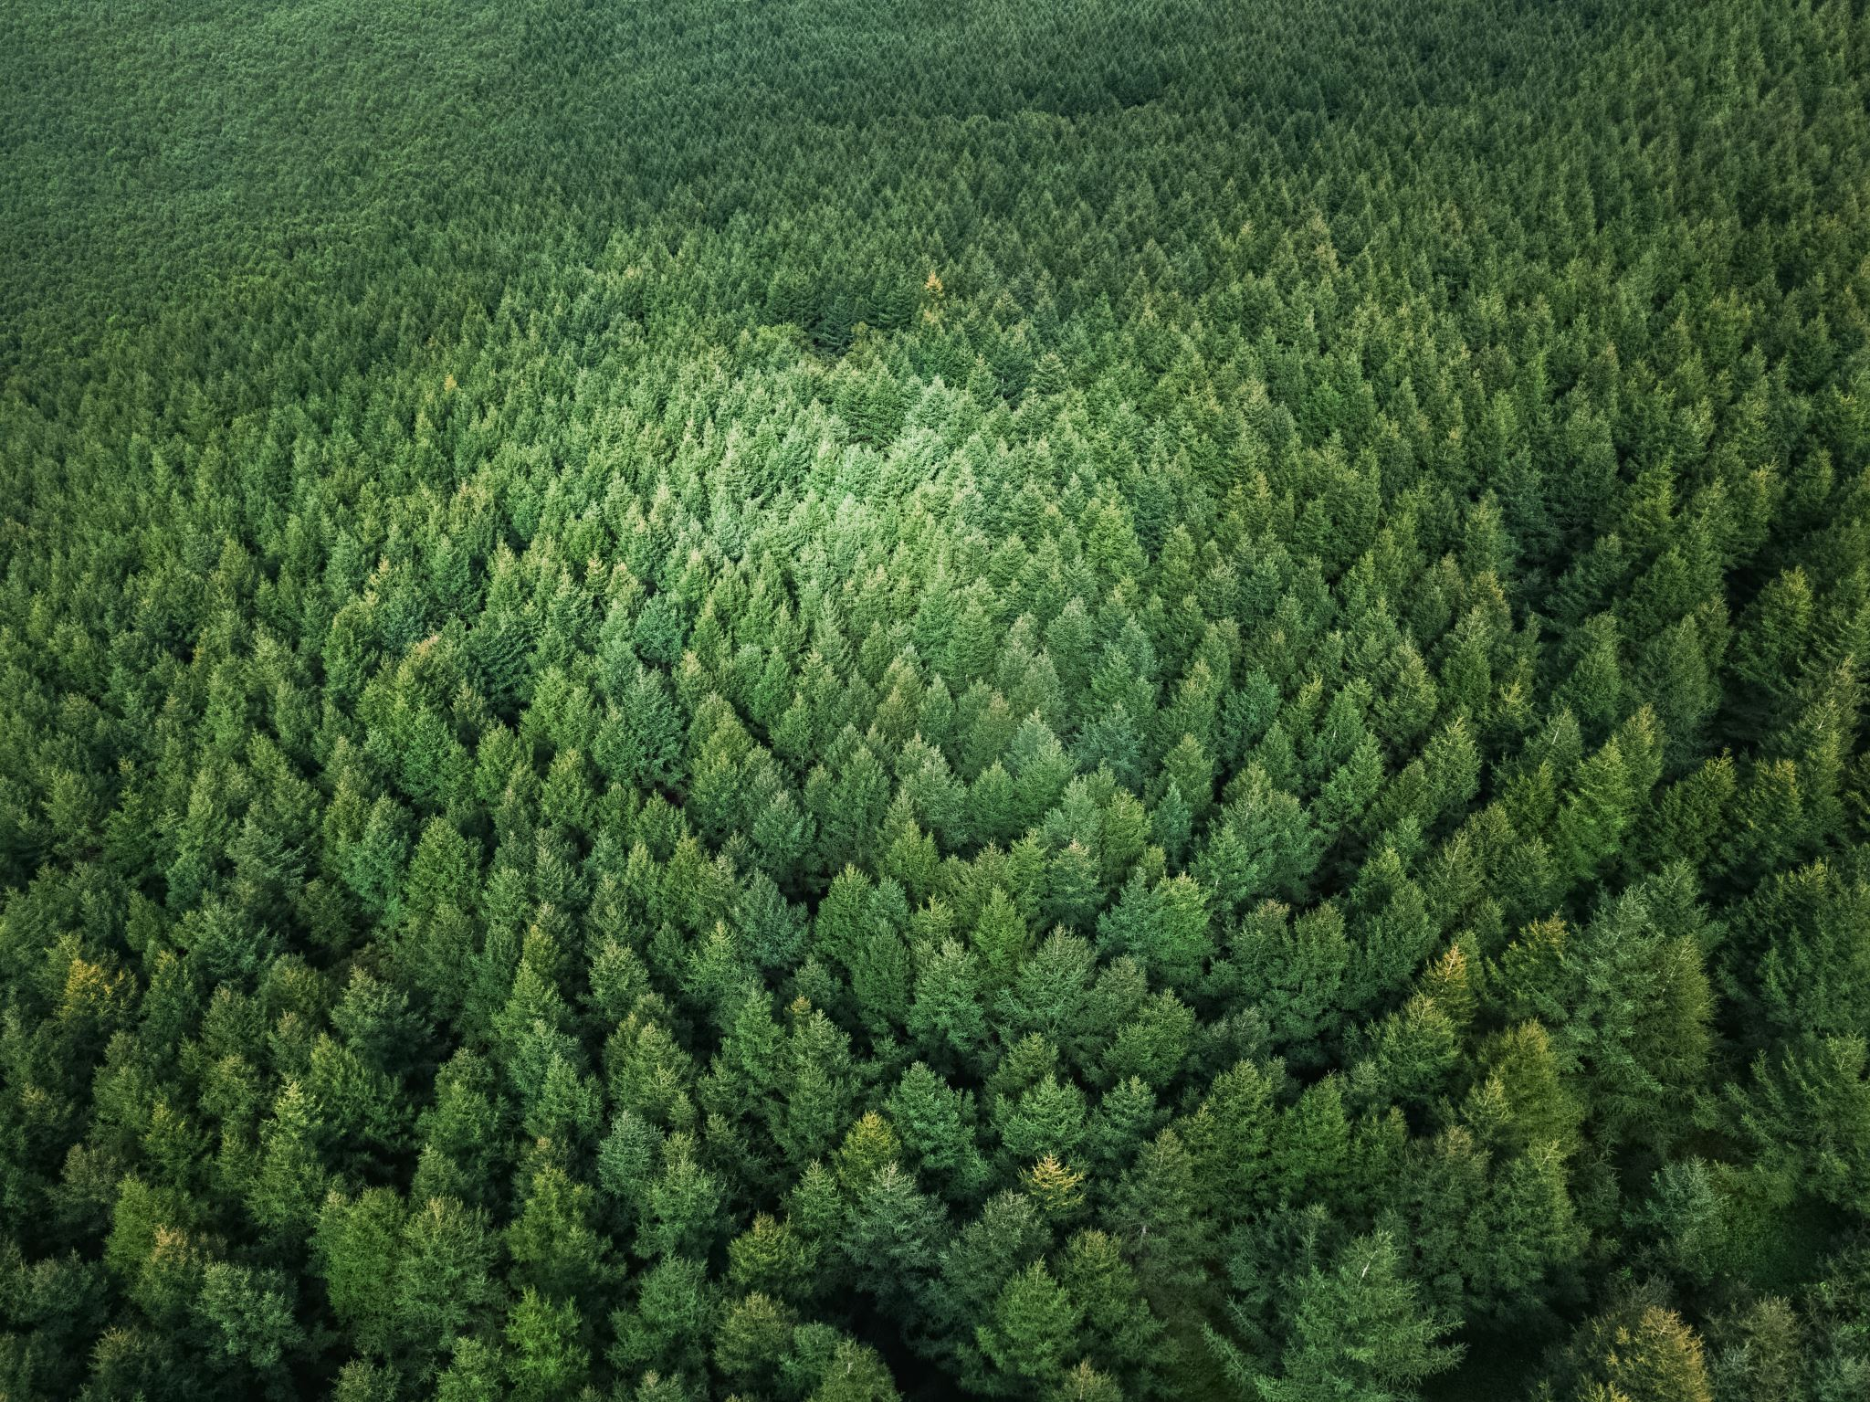
Machine Learning Techniques Used
Decision Trees
K-Fold Cross Validation
K Nearest Neighbours
Random Forests
Train/Test
Correlation Matrix

Slide 7
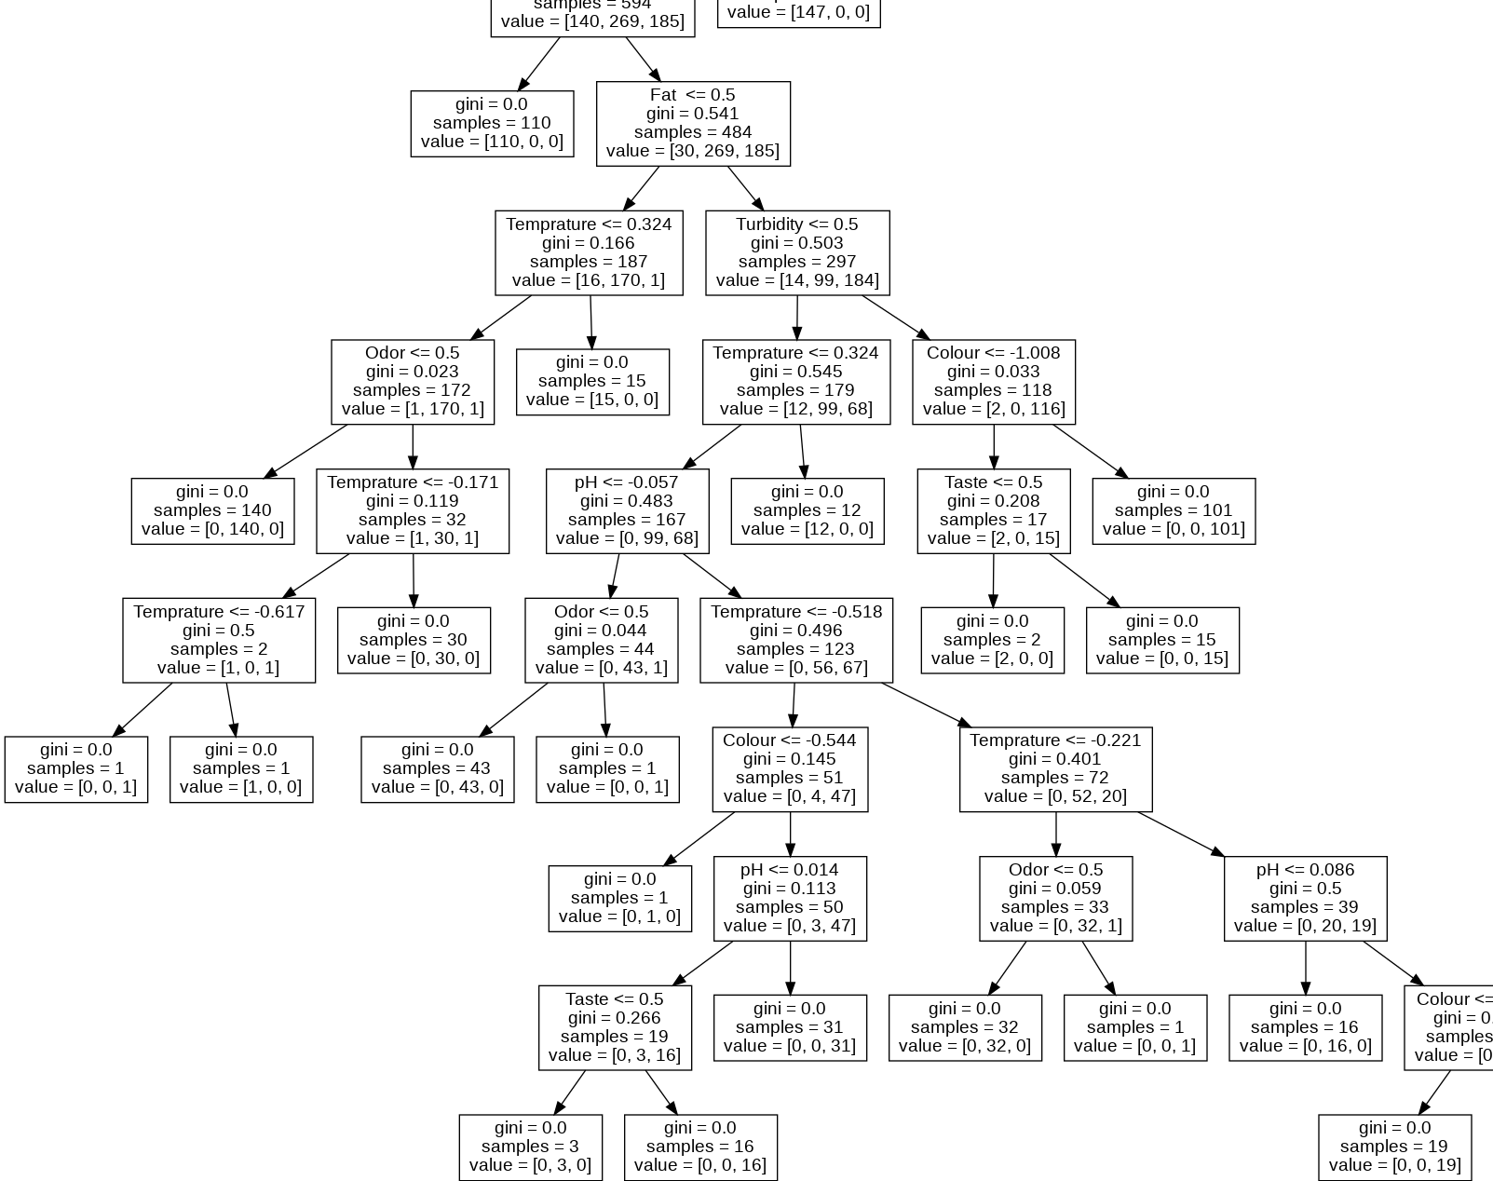
Decision Tree
Accuracy of greater than 99%

Slide 8
K-Fold Cross Validation
Linear accuracy of 86%
Polynomial accuracy of 91%
K-Fold Cross Validation

Slide 9
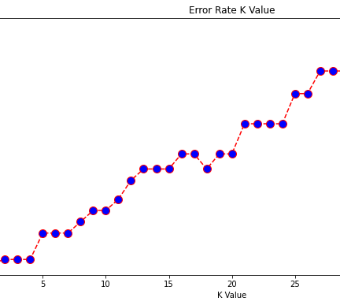
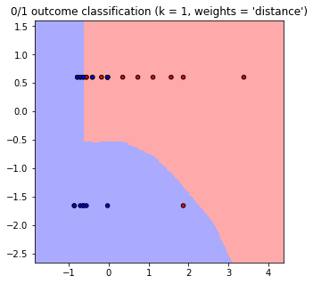
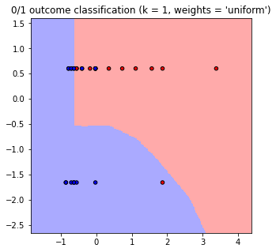
K Nearest Neighbour
K = 1
Accuracy of 50%
Not very accurate
K = 1
Accuracy of 100%
Overfitting?

Slide 10
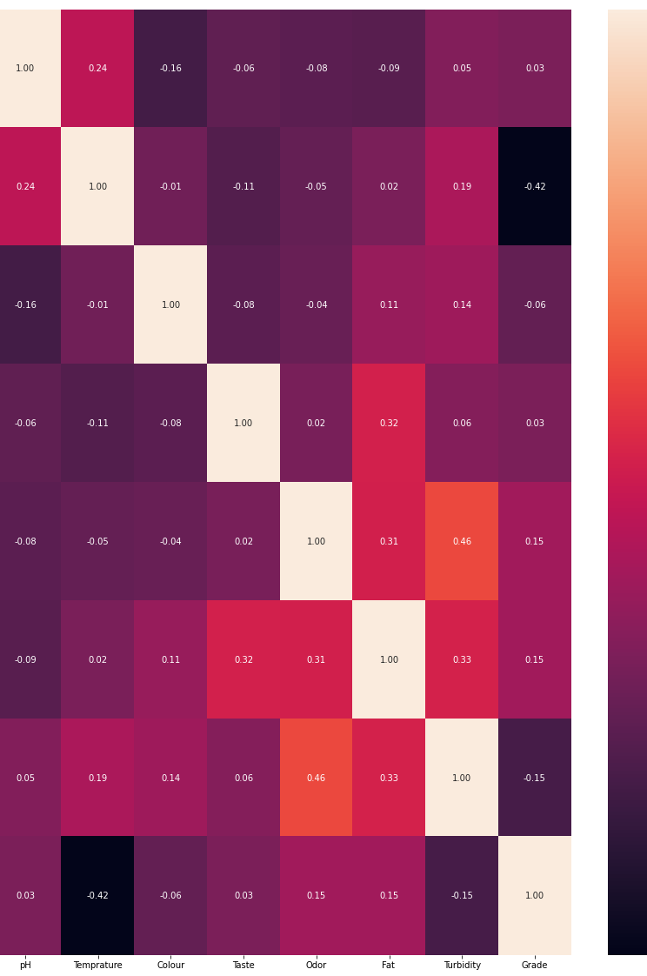
Other Techniques Used
Train/Test
Random Forest
Correlation Matrix

Slide 11

Results and Evaluations
Decision Tree – Almost perfect
K –Fold Cross Validation – Highly effective
K Nearest Neighbours – Effective but could use work

Slide 12

Challenges
Choosing dataset
Deciding some techniques
Decision tree
K Nearest Neighbour

Slide 13
Future Work
Improve techniques
Add more techniques
Automatic milk generator

Slide 14
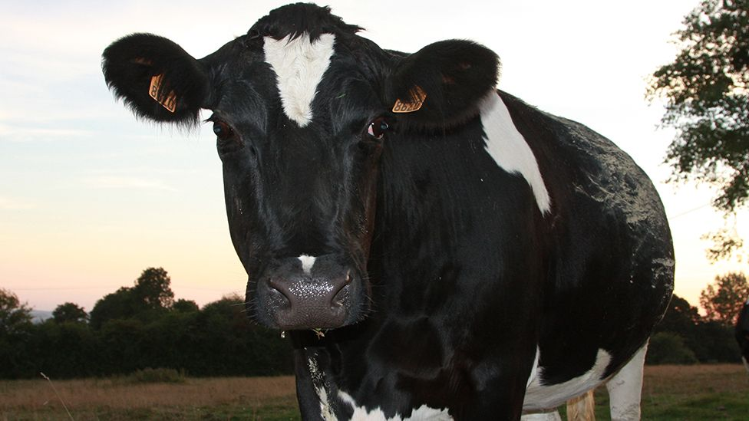
Conclusion
Successful project
Successful Presentation?
Interesting and Fun

Slide 15
References
Dataset – Kaggle, 10/12/2021, https://www.kaggle.com/prudhvignv/milk-grading, accessed 11/12/2021
IT Crowd GIF – GIPHY, 15/01/2013, https://giphy.com/gifs/the-it-crowd-richard-ayoade-fE32ZJgwTysQo , accessed 11/12/2021
Milk – Cedars Sinai, 05/01/2019, https://www.cedars-sinai.org/blog/milk-mania-cow-vs-soy-vs-nut.html , accessed 11/12/2021
AI Brain – Marsner, 2019, https://marsner.com/blog/the-current-state-of-ai/ , accessed 11/12/2021
All other images are taken from my own project or supplied through PowerPoint.

Slide 16
Thanks for Listening
Any Questions?

